Slide 1

stat_ml_project

Slide 2

Title:
Title: "Glass Classification Project"
Name: K.Keerthana
Ht.no: 2203A52096
Serial: 22
Section: AA

Slide 3

Introduction:
Introduction:
Glass is commonly used everywhere now-a-days
Importance:
Glass classification is crucial in various industries, including manufacturing and forensics

Slide 4

Introduction:
The glass dataset describes the chemical properties of glass and involves classifying samples of glass using their chemical properties as one of six classes
By classifying glass, we can know which type of glass is more suitable for the user’s situation

Slide 5
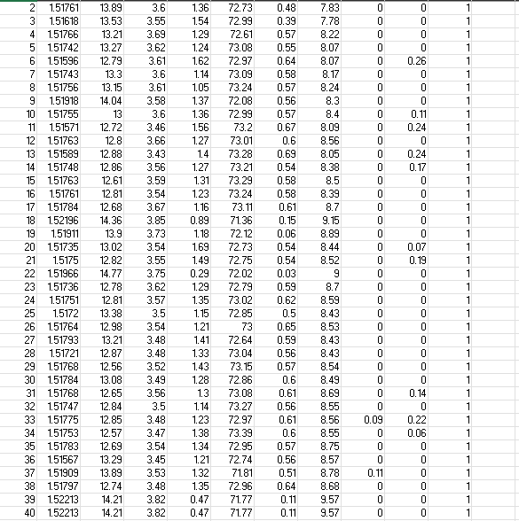

Slide 6

Data Exploration:
Data Loading: I started by loading the dataset using the Pandas library
The shape of glass data set is 214 rows and 10 columns
The 10 columns of the dataset are as follows
RI: refractive index
Na: Sodium
Mg: Magnesium
Al: Aluminium

Slide 7
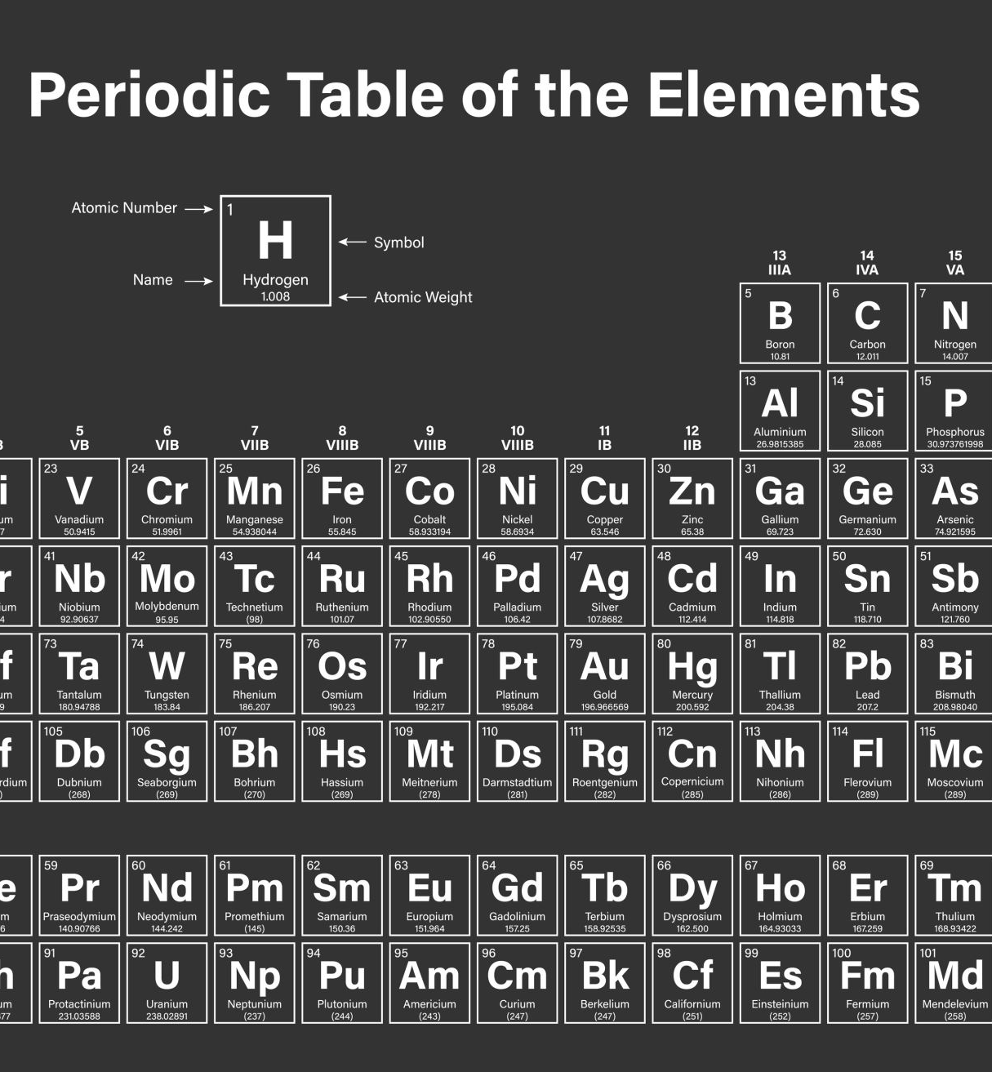
Data Exploration:
Si: Silicon
K: Potassium
Ca: Calcium
Ba: Barium
Fe: Iron
Type

Slide 8

Data Exploration:
Datatypes: All the column values are float values except type of glass column
Null: I used isnull() and isnull() .sum() to find out if any null values are present

Slide 9
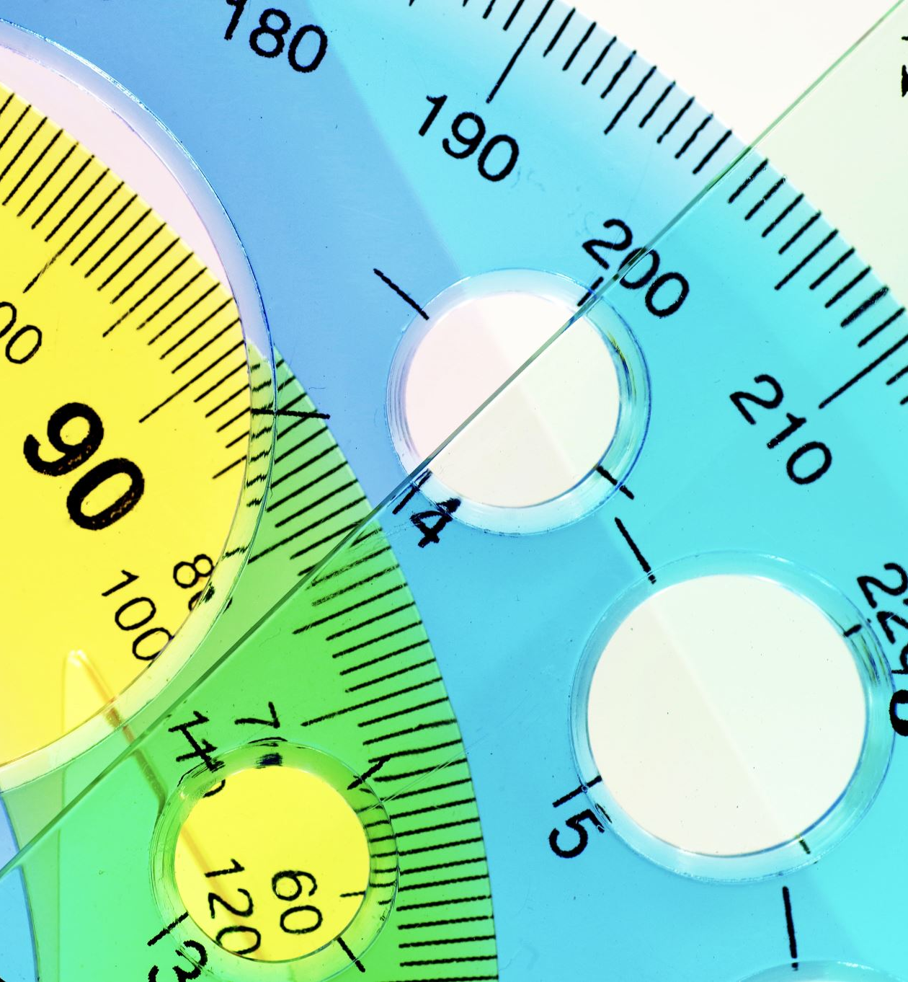
Target variable and features:
Type is identified as target variable.so, it is taken as y value
The printed set to know the values of y
Set doesn’t allow repetitions so; it prints the value only once
1,2,3,5,6,7 are the values of y

Slide 10

Target variable and features:
The values of y represent the type of glass as shown below
1 building_windows_float_processed
2 building_windows_non_float_processed
3 vehicle_windows_float_processed
4 vehicle_windows_non_float_processed
5 containers
6 tableware
7 headlamps

Slide 11
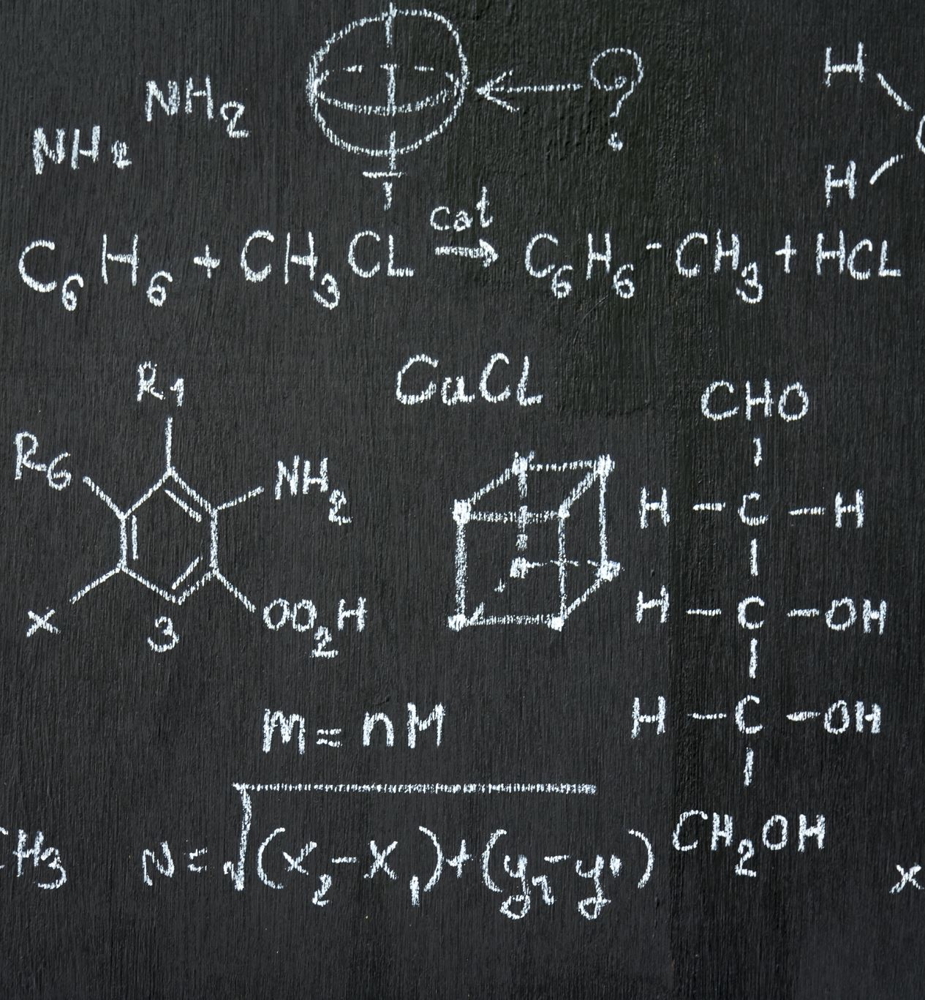
Target variable and features:
By using len(a[a['Type of glass'] == 1]) we can find number of rows are there for each class of y value
Class 1: 70 samples
Class 2: 76 samples
Class 3: 17 samples
Class 4: 0 samples

Slide 12
Target variable and features:
Class 5: 13 samples
Class 6: 9 samples
Class 7: 29 samples
Features are defined by dropping y value from dataset

Slide 13

Data exploration through histogram:
Histograms for each column in the dataset is generated to make it easy to visualize the distribution of each feature
After looping through all the columns in the Dataset, the code plots a histogram specifically for the 'Type' column, which is the target variable

Slide 14
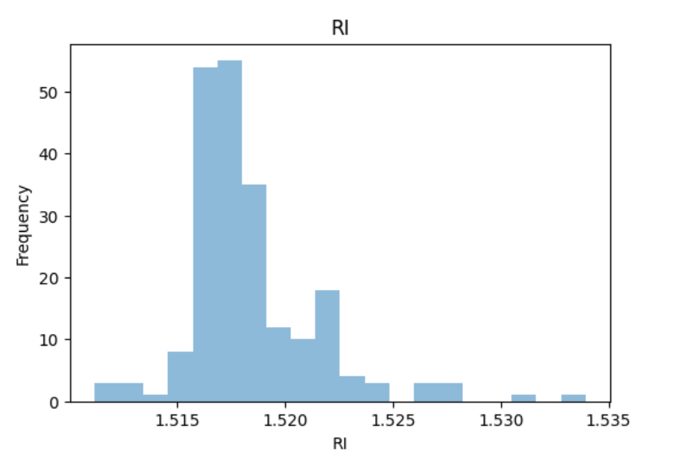
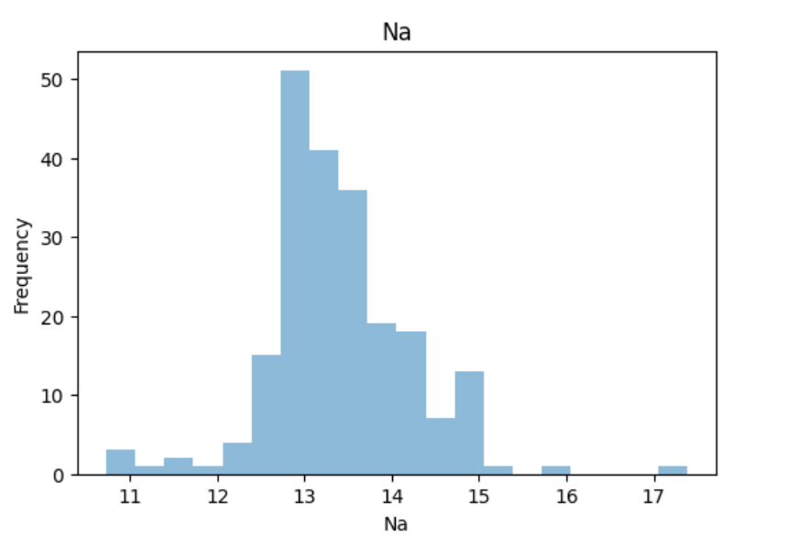
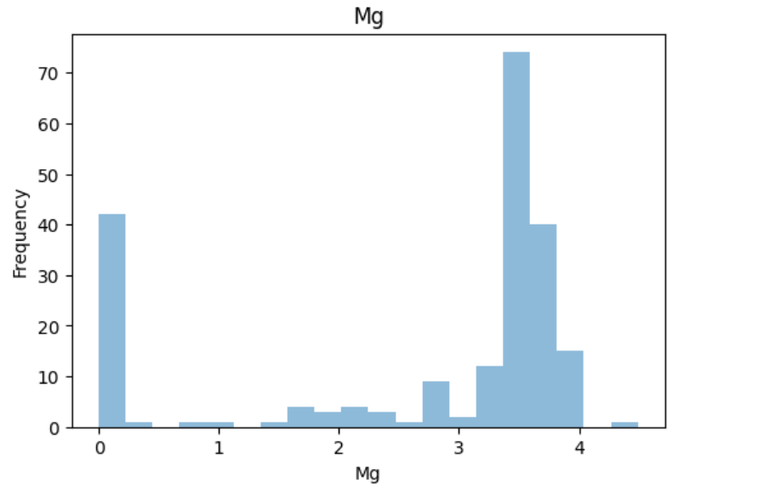
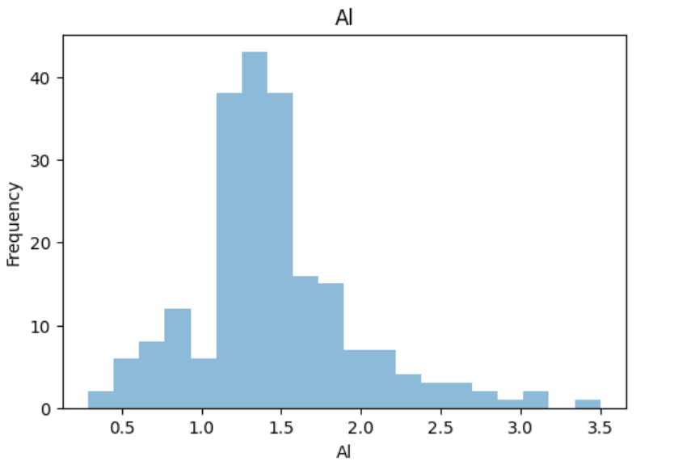
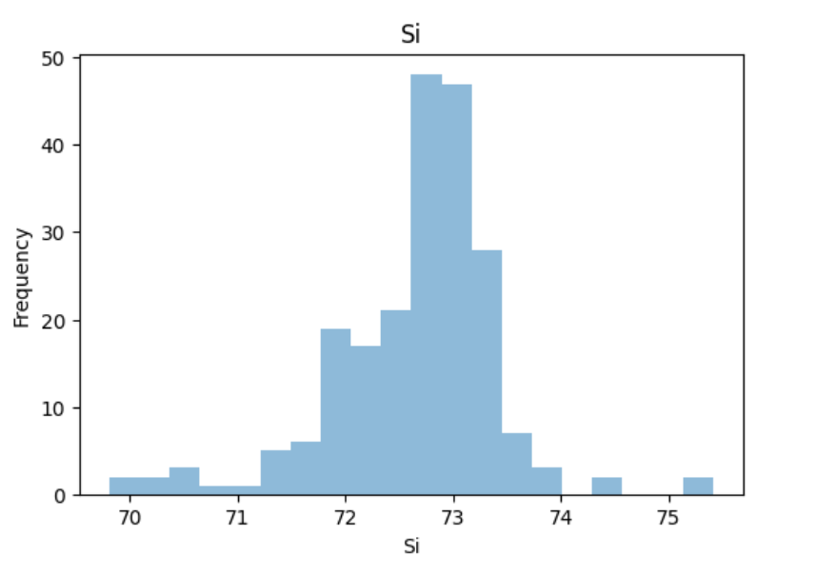

Slide 15
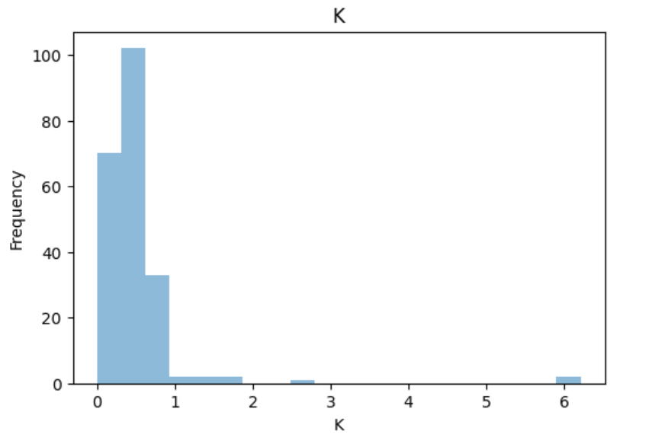
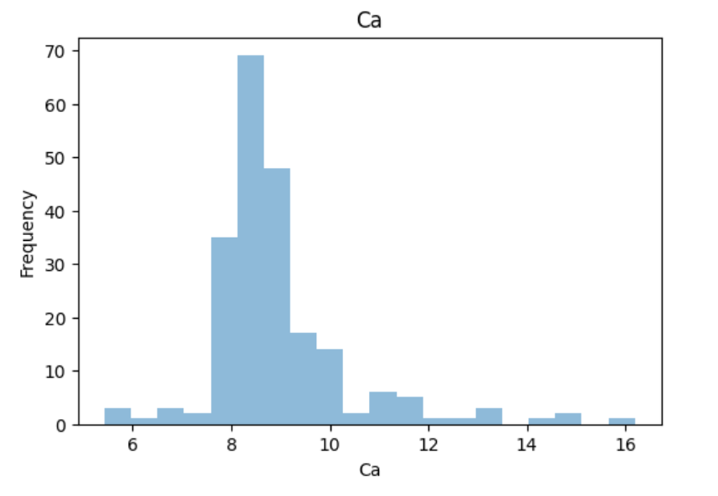
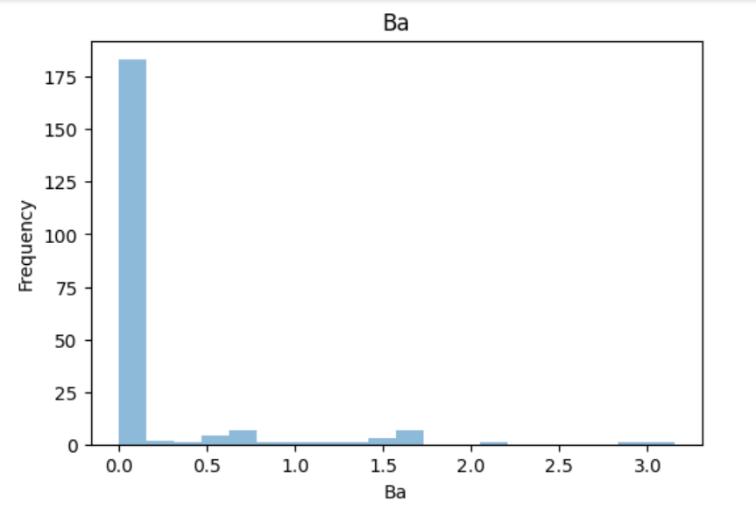
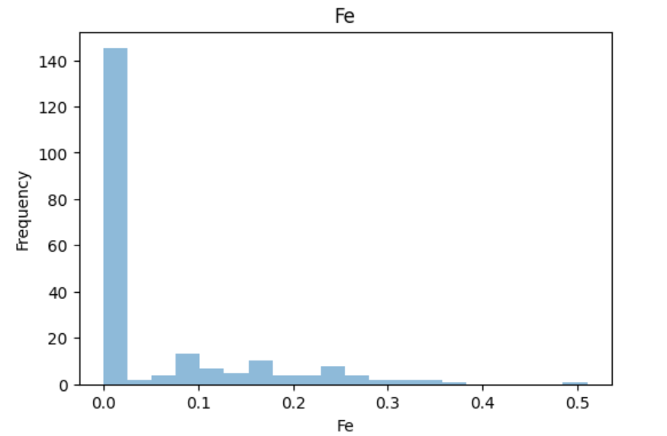
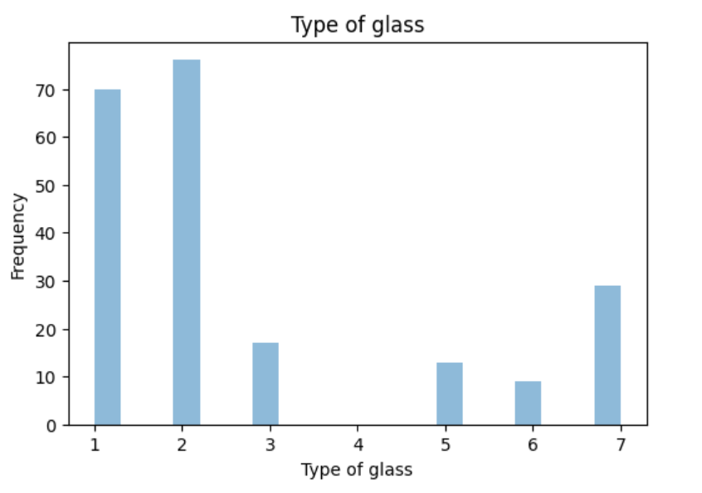
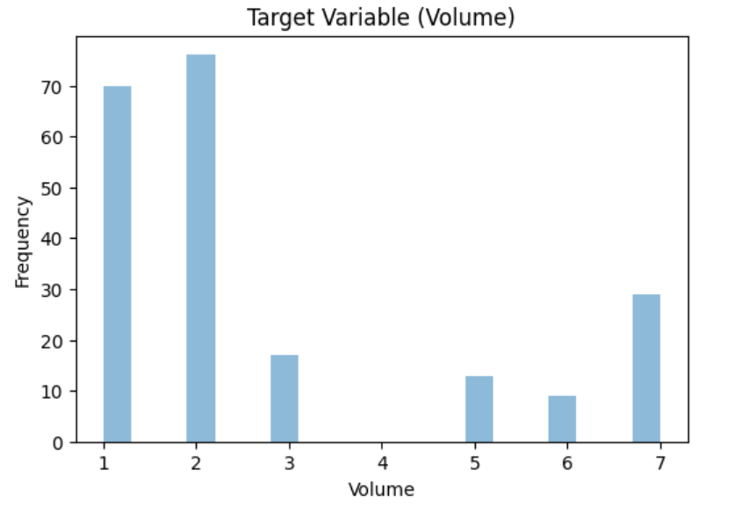

Slide 16
Data exploration through histogram:
Another set of histograms are drawn to showcases the creation of multivariate histograms, which allows for the visualization of how different categories are distributed within a dataset
Multivariate histograms are useful for understanding the distribution of data across multiple categories, which can be valuable for tasks such as classification or clustering

Slide 17
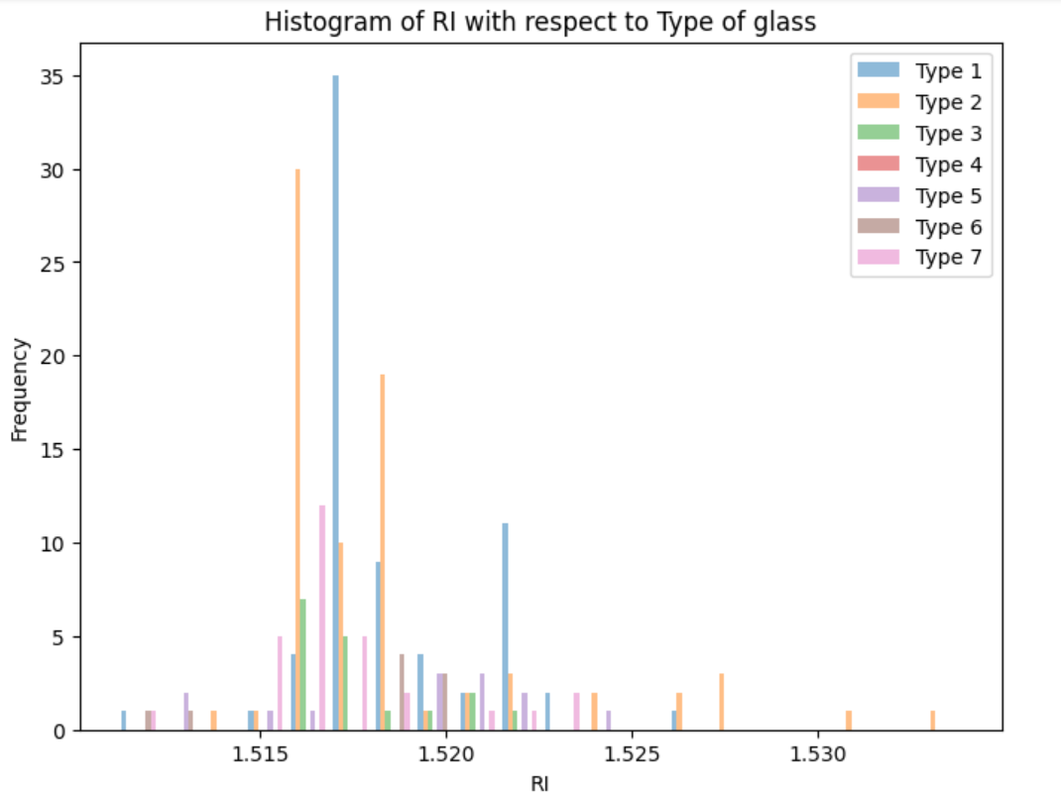
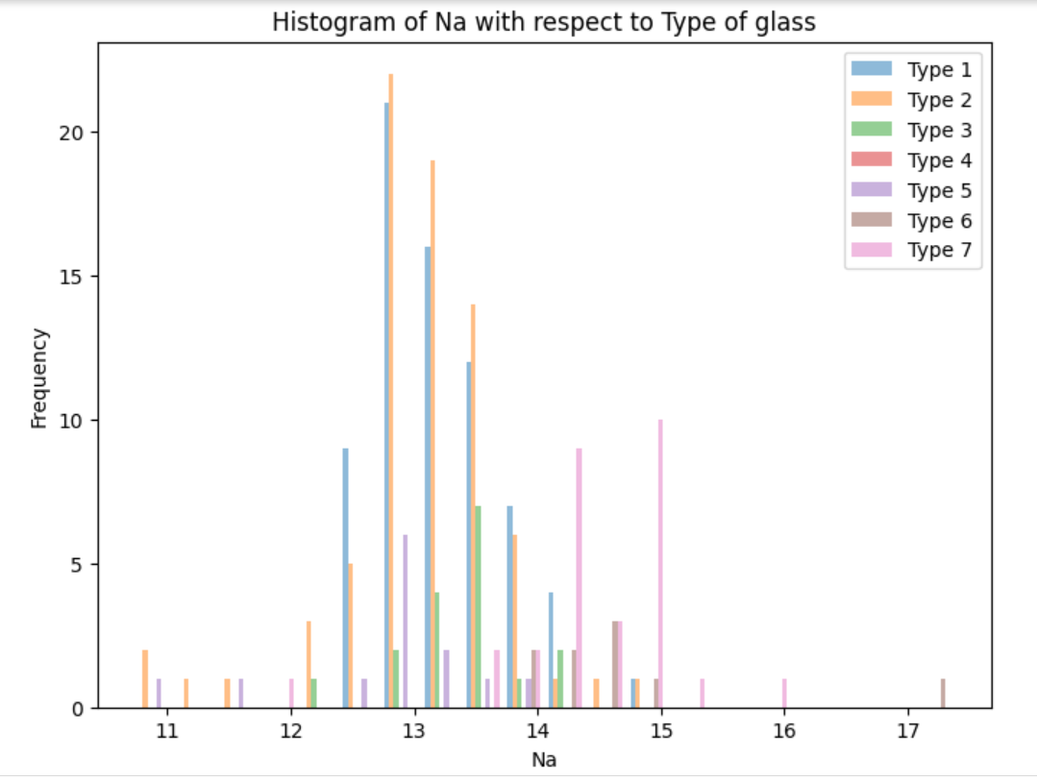
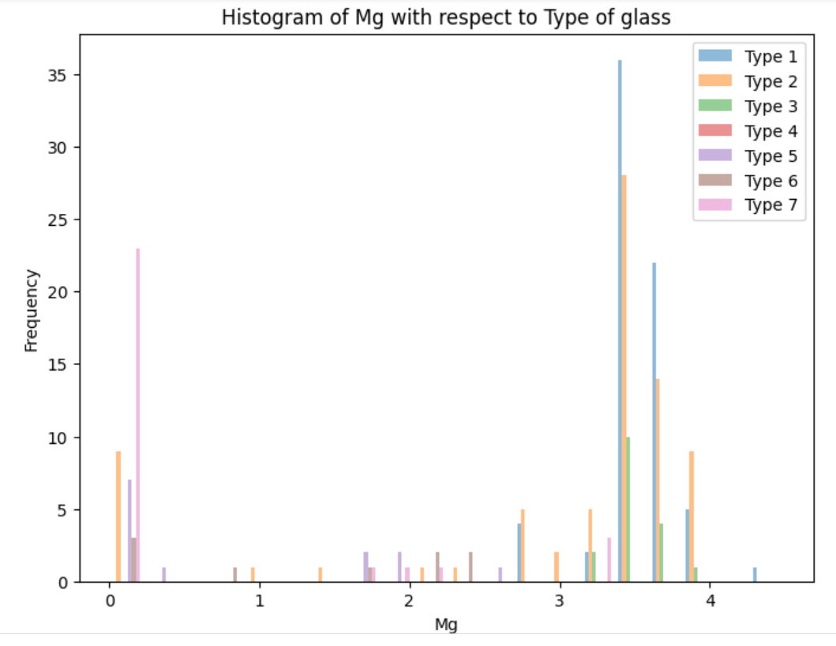
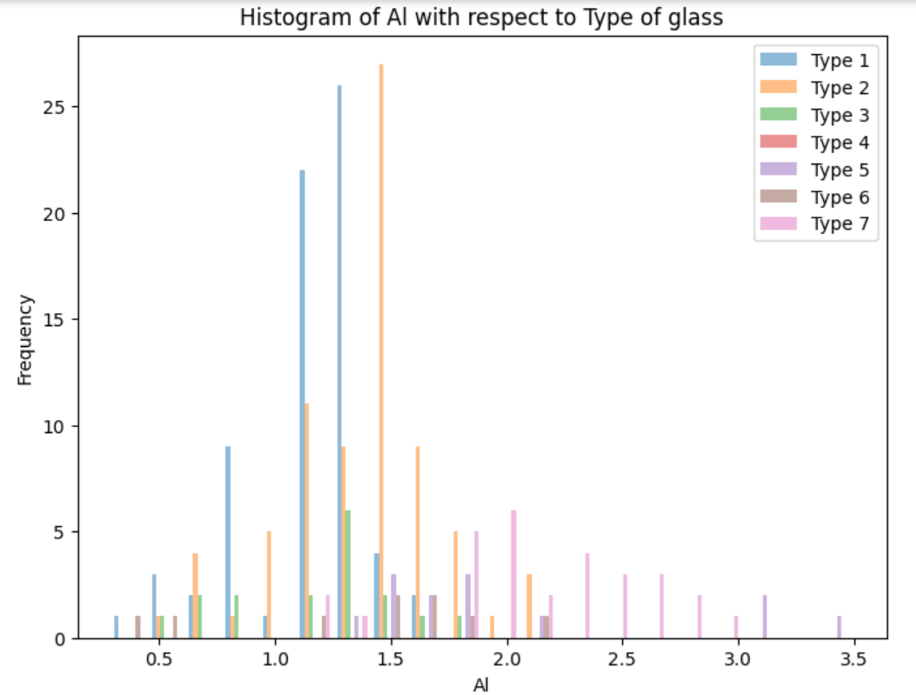
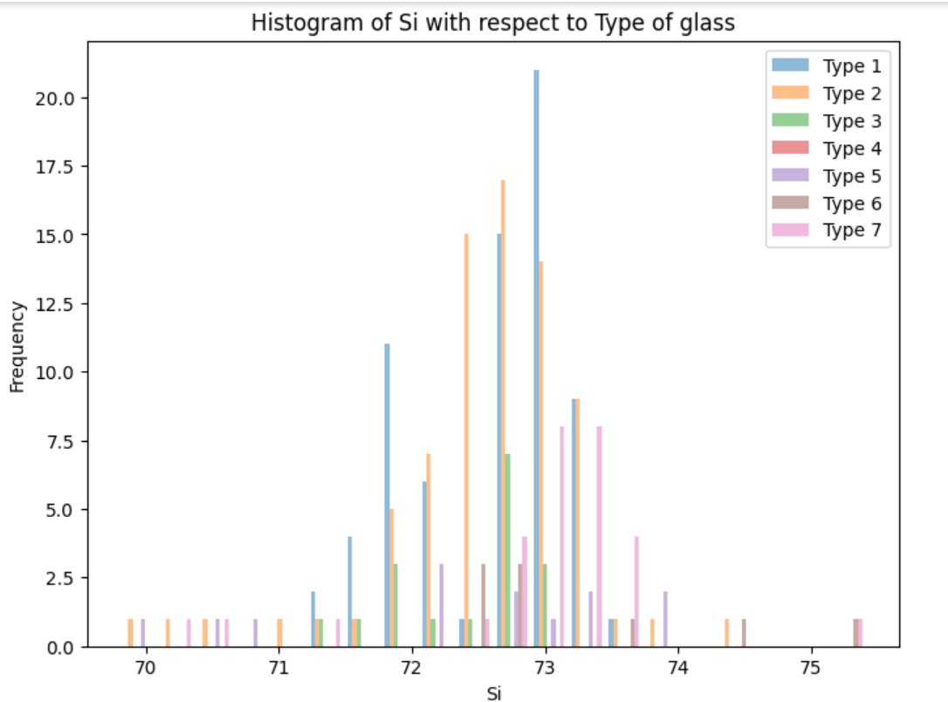

Slide 18
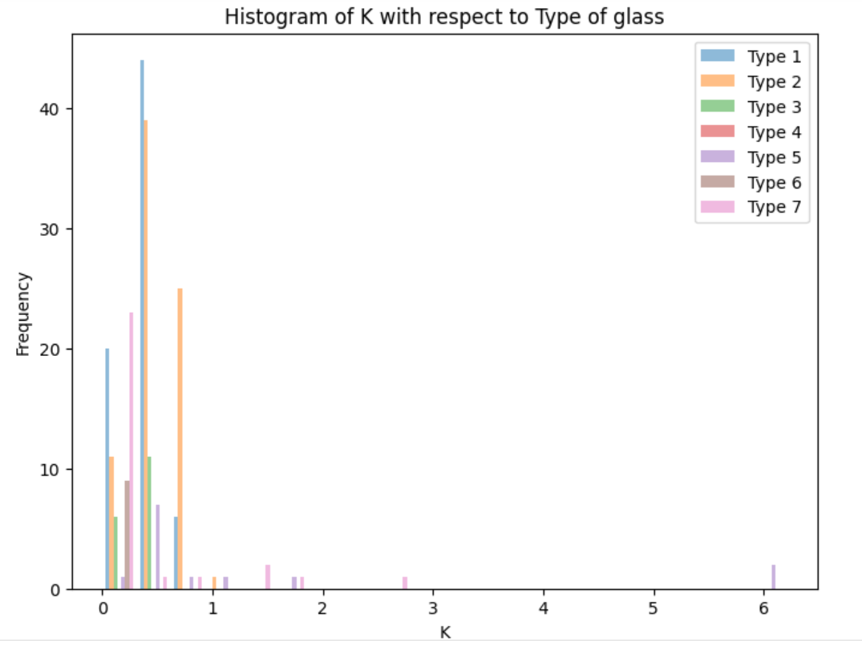
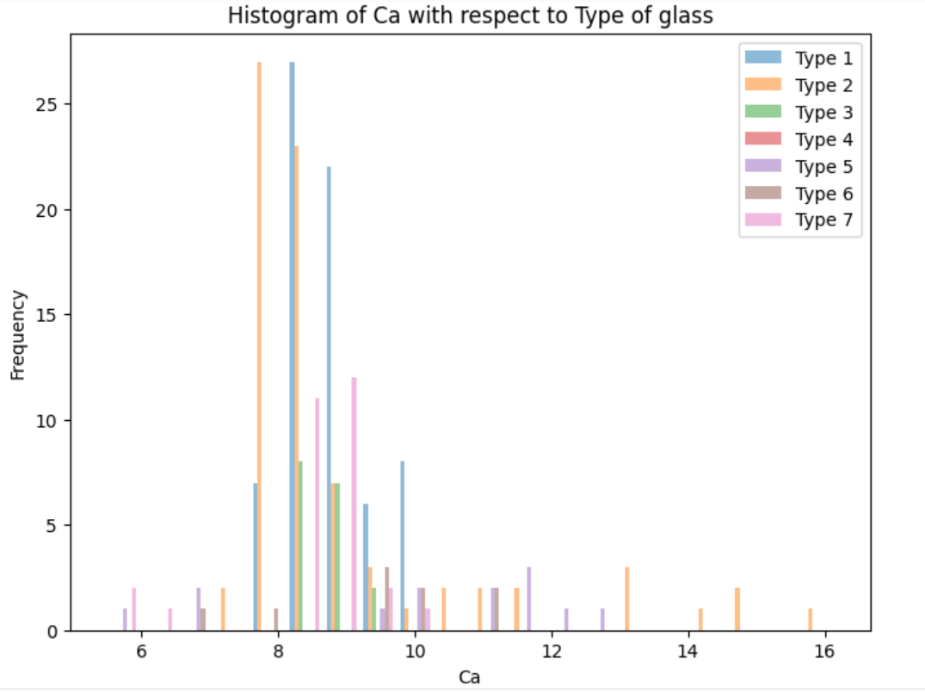
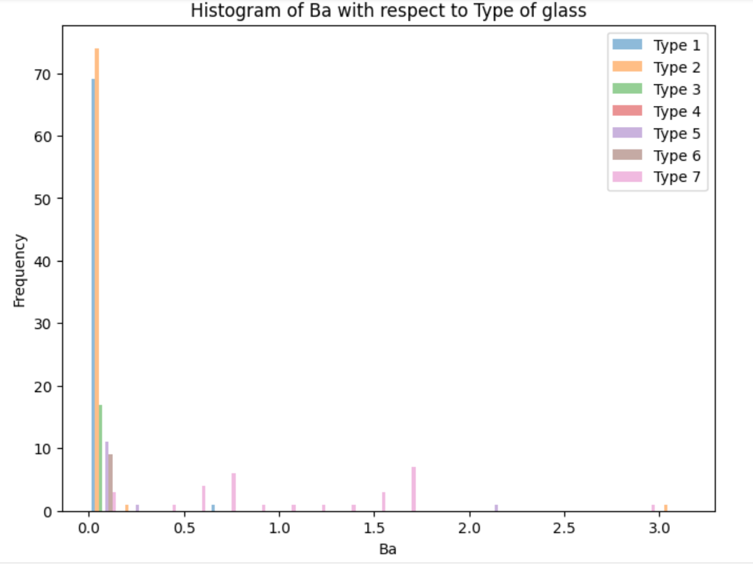
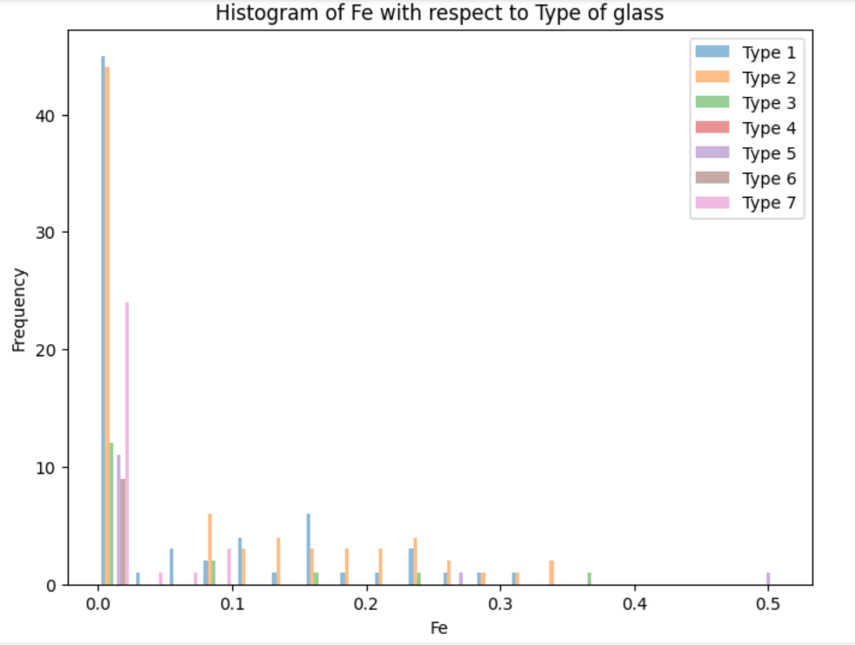

Slide 19

Slide 9: Smote
SMOTE is a technique used to create synthetic samples of the minority class to balance the class distribution
The random_state parameter is set to ensure reproducibility
After applying SMOTE, X_resampled and y_resampled contain the resampled feature and target data, respectively, with a balanced class distribution

Slide 20
Data Splitting
Data Splitting: I split the data into training and testing sets using the train_test_split function.
Test Size: I chose a test size of 0.2, meaning 20% of the data is used for testing.
Random State: I set a random state to ensure reproducibility.

Slide 21
Scaling
Standardization (also known as z-score normalization) is a common preprocessing step to ensure that all features have similar scales and distributions.
By Standard scaler equal priority is given to all features
Standardizing both the training and testing data is essential to ensure that the model performs consistently across all data points.

Slide 22

SVM Model:
SVM Model: Support Vector Machines were introduced as another classification technique
Kernel Selection: I explained the choice of the radial basis function kernel
Hyperparameters: Mentioned the selected hyperparameters
Training and y predicted: I showed the code for training and testing the SVM model and displayed they predicted values achieved

Slide 23

Confusion matrix:
The confusion matrix is a valuable tool for assessing the performance of a classification model
It helps you understand how well your model is classifying data by showing true positives, true negatives, false positives, and false negatives
Heatmaps are a helpful way to visualize the confusion matrix and gain insights into model performance
After confusion matrix accuracy of svm model is printed

Slide 24
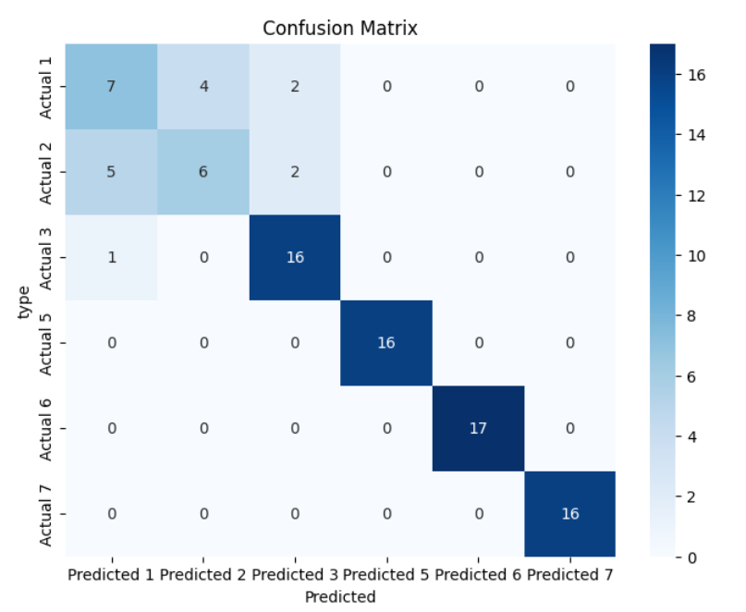

Slide 25
F1 Score
The F1 score is a metric that combines precision and recall into a single value.
It balances both false positives and false negatives and is particularly useful when class imbalance is present.
The formula for F1 score is: 2 * (precision * recall) / (precision + recall).

Slide 26
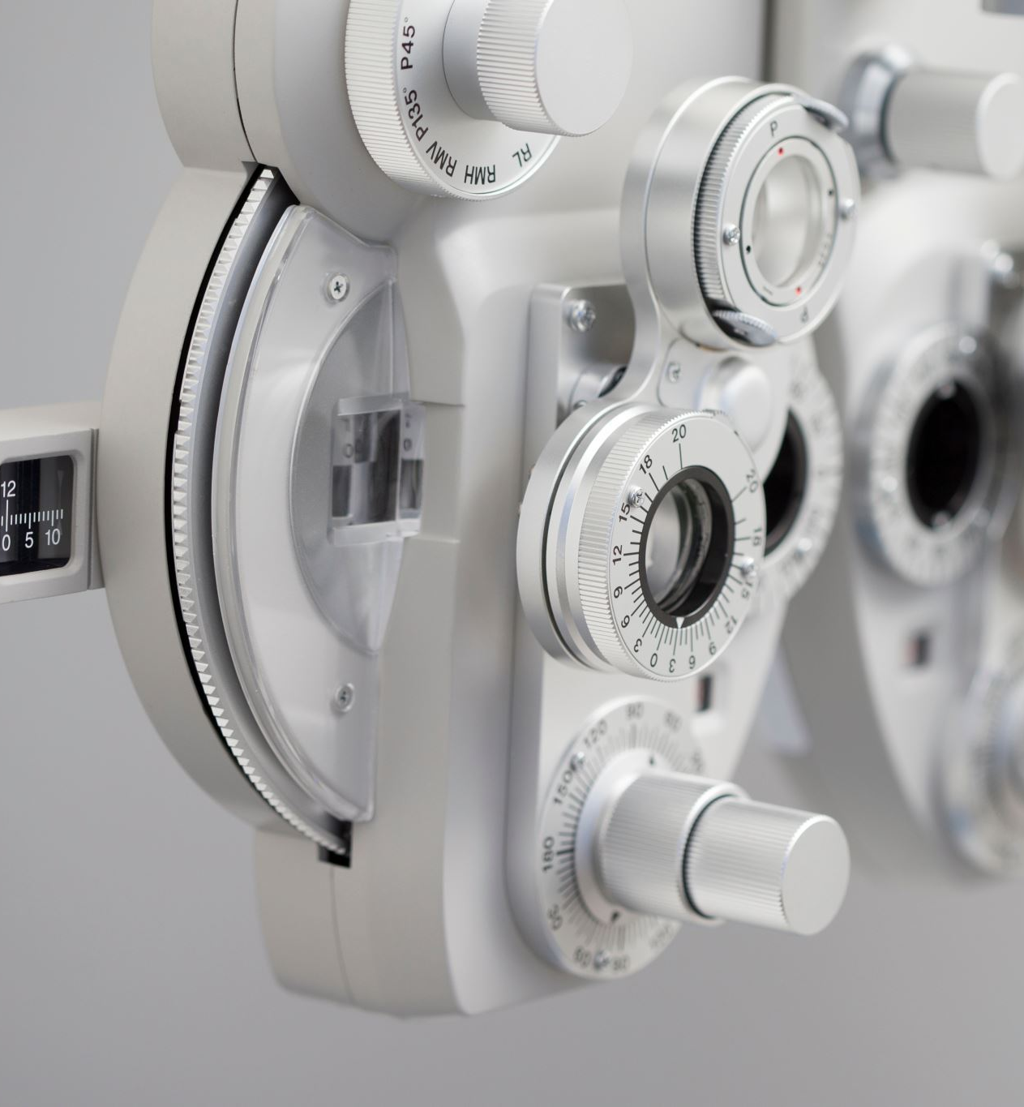
Precision
Precision measures the accuracy of positive predictions made by the model
It is the ratio of true positive predictions to the total positive predictions
High precision indicates that when the model predicts positive, it is more likely to be correct

Slide 27
Recall
Recall, also known as sensitivity or true positive rate, measures the model's ability to capture all positive instances.
It is the ratio of true positive predictions to the total actual positives (true positives + false negatives).
High recall indicates that the model can identify most of the positive instances.

Slide 28

Classification Report:
A classification report is a comprehensive evaluation summary for a classification model
Reviewing the classification report helps identify which classes the model performs well on and which ones need improvement
A good model will have high values for precision, recall, and F1 score across all classes

Slide 29
KNN
model
Knn stands for K-Nearest Neighbors
It Works for both classification and regression.
Handles complex, non-linear relationships effectively.

Slide 30
'k_values' are defined, representing the number of neighbors to consider.
An empty list is taken for storing performance scores.
Knn models are created for each 'k' value.
Models are trained and predicted values are obtained.
Accuracy is calculated and are printed.
Accuracy using knn model with k=1: 0.9021739130434783

Slide 31
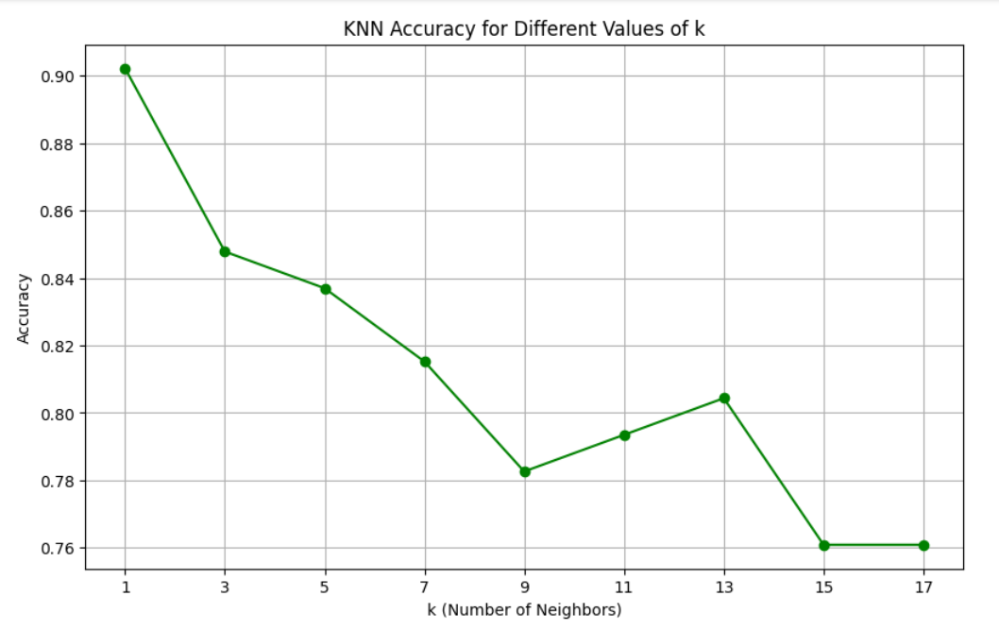
A graph is plot showing how the accuracy of the KNN model changes with different values of 'k,'

Slide 32
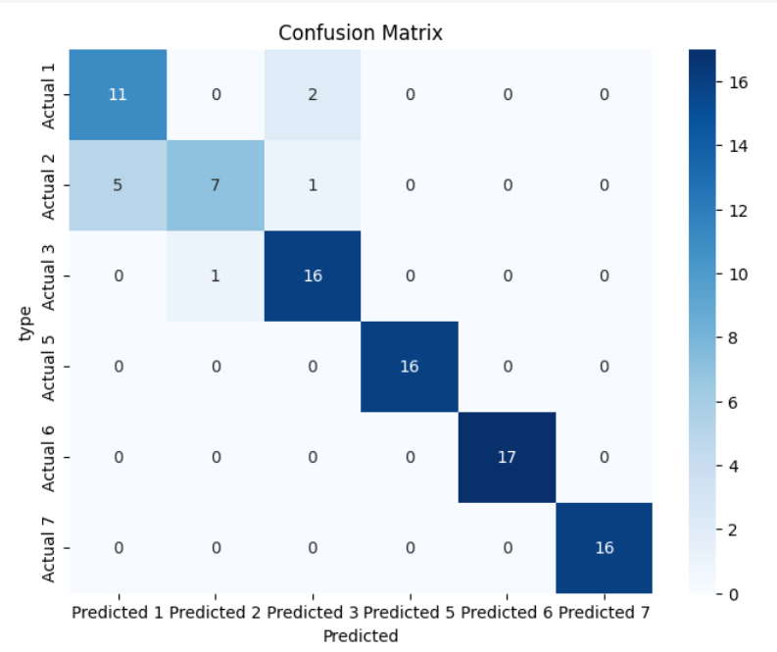
Confusion matrix of knn model

Slide 33
Logistic Regression is a supervised machine learning algorithm. Although it is not possible to find accuracy of a multi class classification manually but using libraries we can find.
Sigmoid function is used to get the values between 0 and 1.
Then the model is trained, and values are predicted.
Accuracy using logistic regression: 0.8152173913043478
Logistic regression

Slide 34
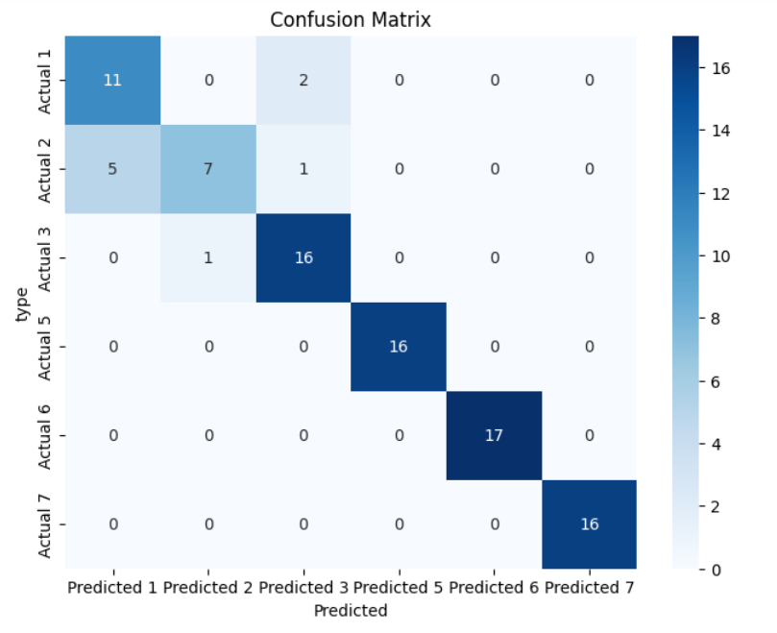
Confusion matrix for logistic regression model

Slide 35
Bootstrap method
Bootstrapping is a resampling technique that helps in estimating the uncertainty of a statistical model.
It includes sampling the original dataset with replacement and generating multiple new datasets of the same size as the original.
Each of these new datasets is then used to calculate the desired statistic, such as the mean or standard deviation.

Slide 36
This process is repeated multiple times, and the resulting values are used to construct a probability distribution for the desired statistic.
This technique is often used in machine learning to estimate the accuracy of a model, validate its performance, and identify areas that need improvement.

Slide 37
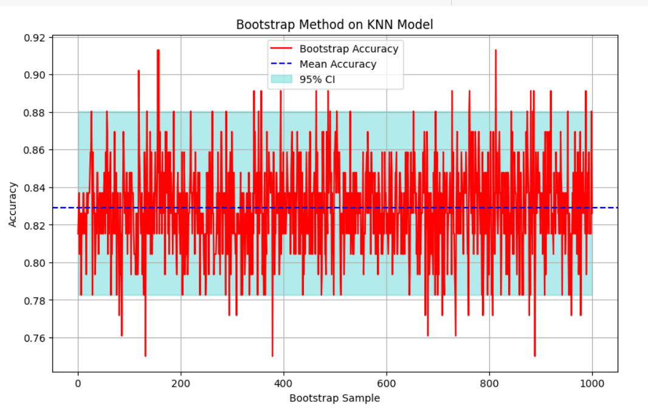
Bootstrap Method on svm model

Slide 38
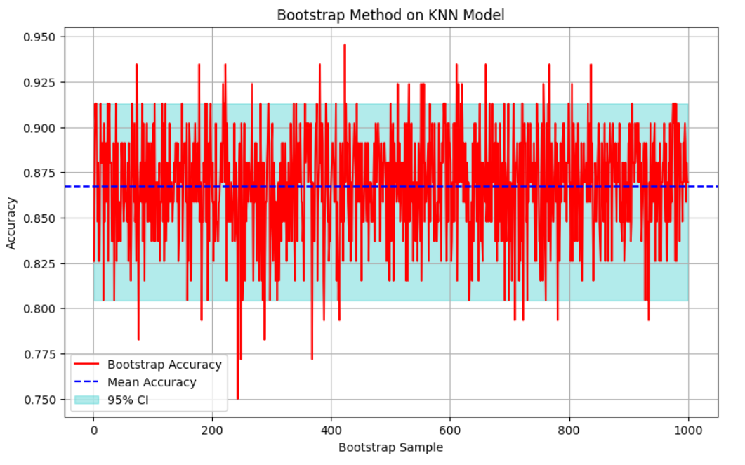
Bootstrap Method on knn model

Slide 39
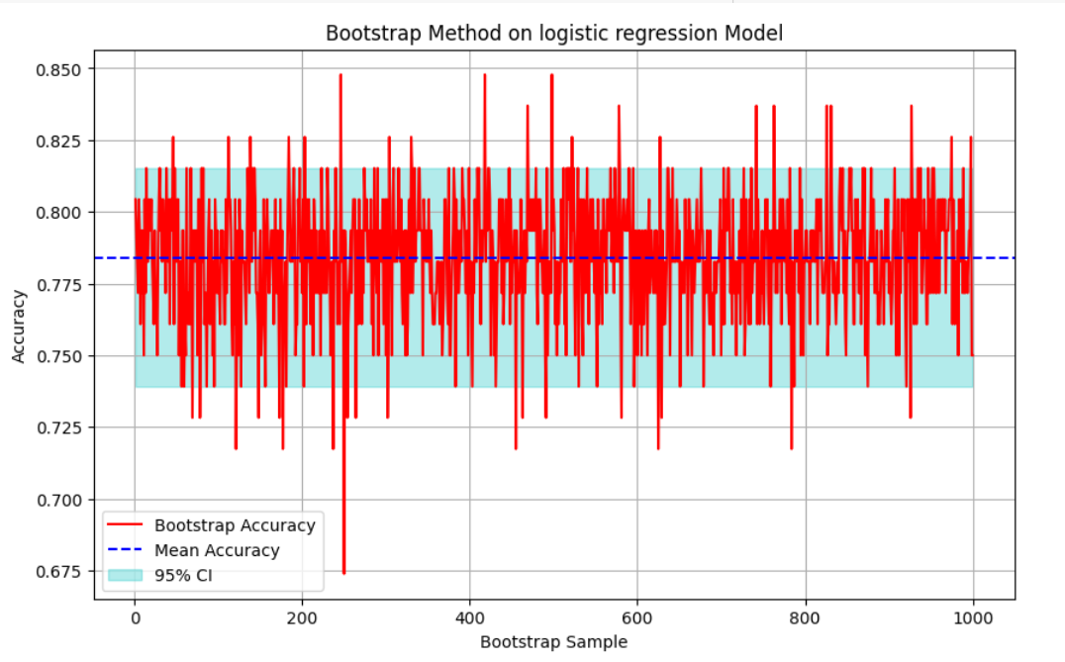
Bootstrap Method on logistic regression model

Slide 40
Comparisions
Many others did not use smote to increase number of samples since it is an imbalanced and multi class dataset
Few used pca to reduce no of columns but I choose not to do so since there are only 9 features .
MY RESULTS(accuracies) are as follows:
SVM: 0.8425(84.2%)
KNN:0.90217(90.2%)
Logistic regression:0.815217(81.5%)

Slide 41
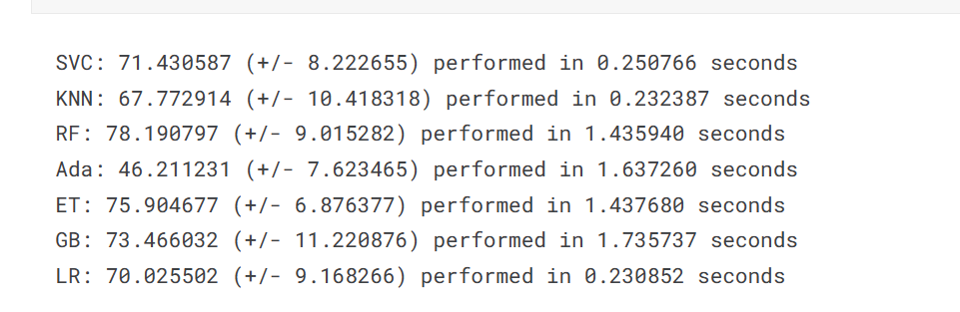
ELIE KAWERK(RESULTS):

Slide 42
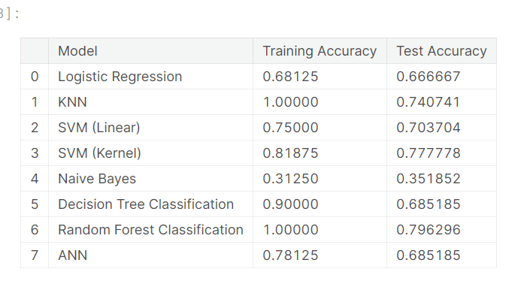
Glass Classification Analysis with EDA(RESULTS):

Slide 43
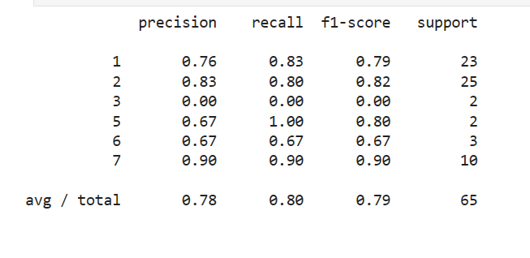
P-SAMA(RESULTS):

Slide 44

Conclusion
By seeing accuracy, bootstrap graph and confusion matrix I can come to a conclusion that KNN model is best fit model for this dataset.

